Slide 1
In-context learning (ICL) linear functions
Kebei Jiang
02/08/2024

Slide 2
Disclaimers
I will be saying “I don’t know” a lot
Slides are mostly screenshots taken from recordings associated with the papers
In-Context Learning: A Case Study of Simple Function Classes
What Learning Algorithm is In-Context Learning?

Slide 3
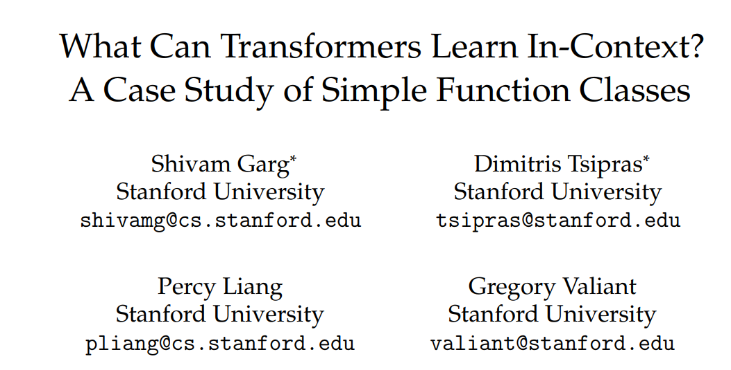
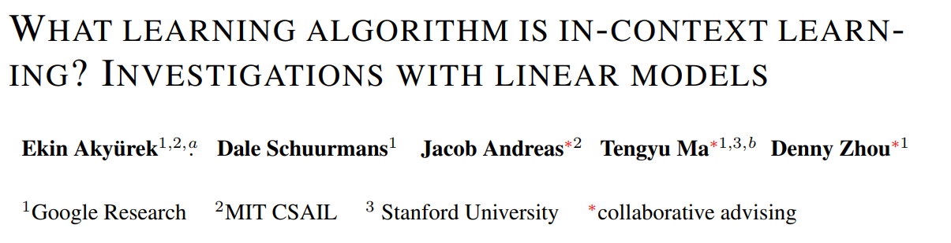
What can transformers learn in-context
“Proposed an interpretable and theoretically amenable setting for understanding ICL in transformers”
How do transformers learn in-context
Focus on Transformers and linear regression

Slide 4
Is it really in-context learning?
Yes. Empirical proof by training in-context learner of simple functions
Are the learned/encoded algorithms any good?
Yes. They are robust on out-of-distribution data

Slide 5
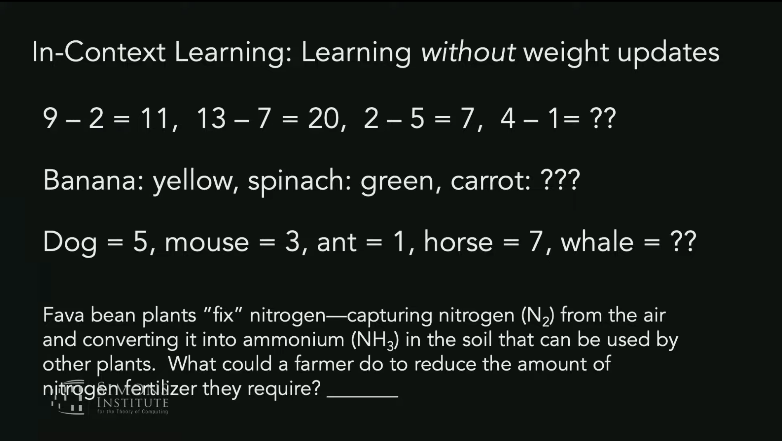

Slide 6
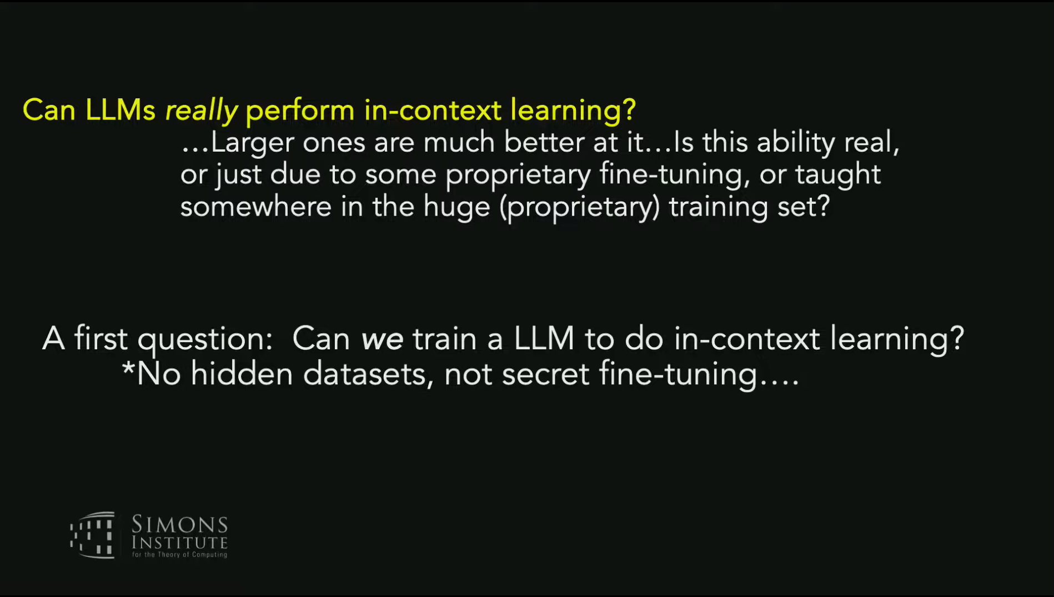

Slide 7
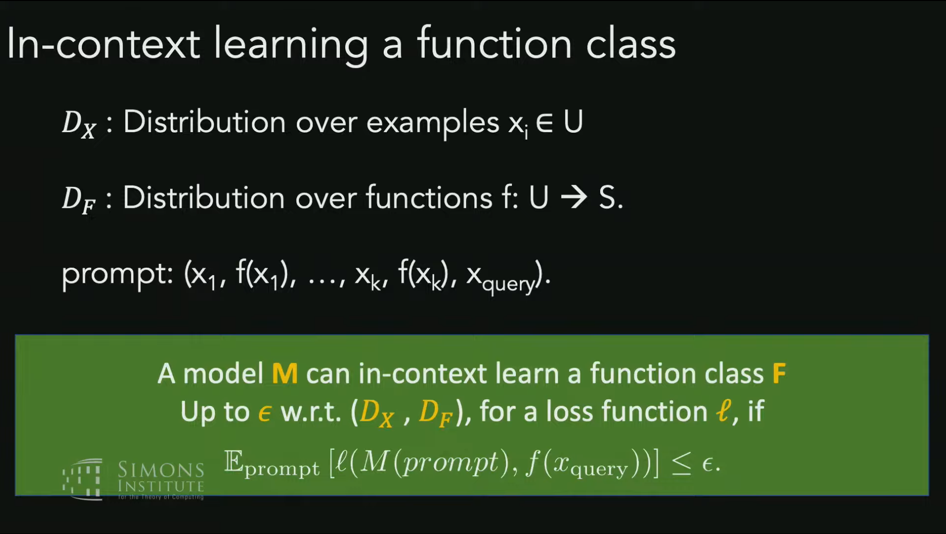

Slide 8
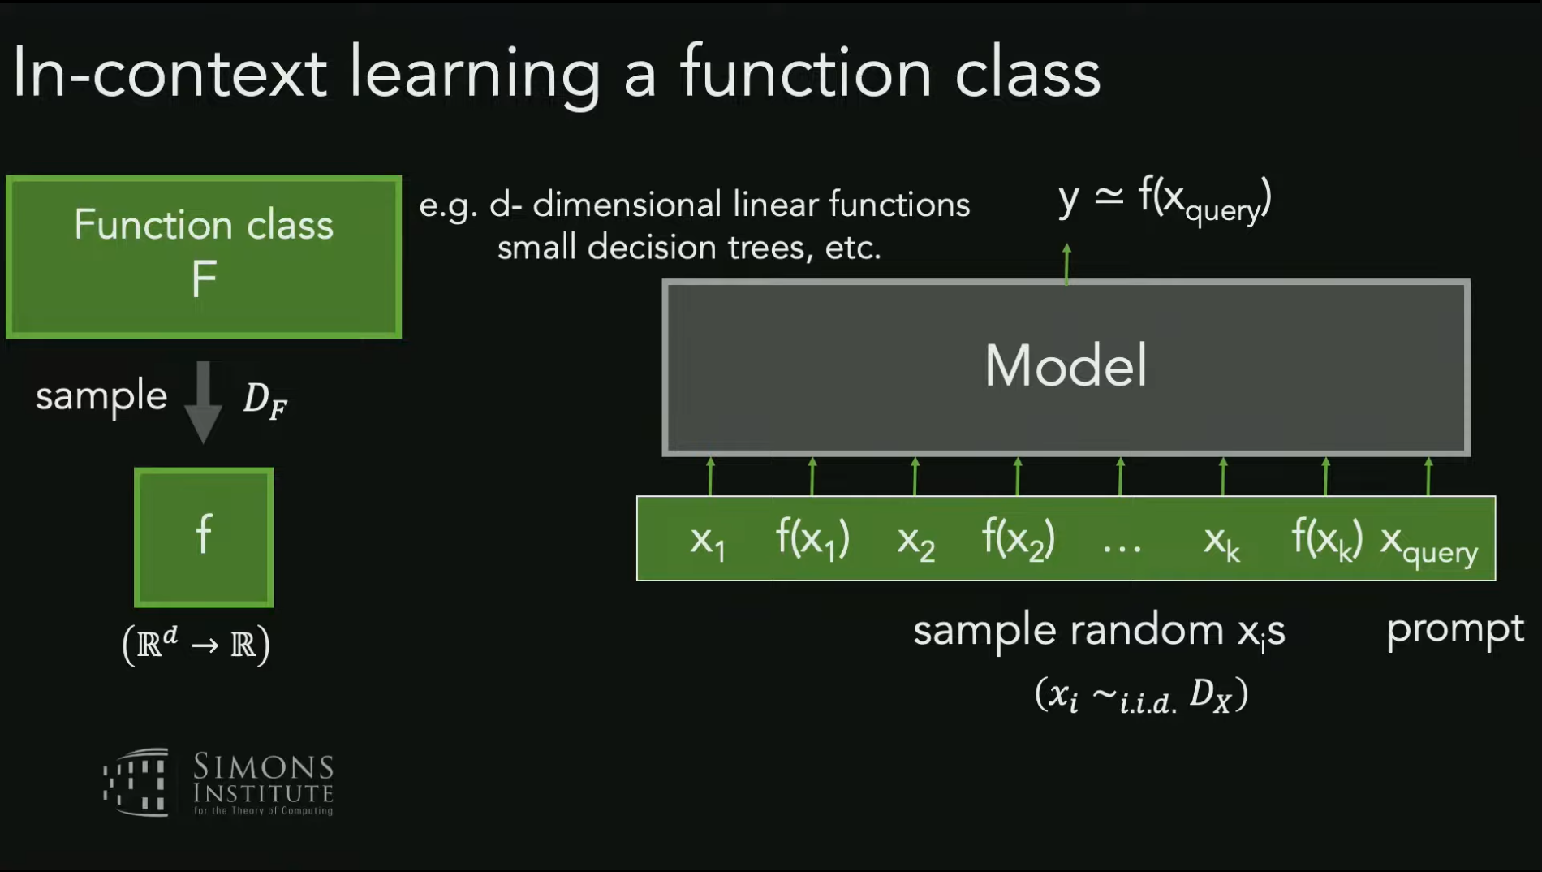

Slide 9
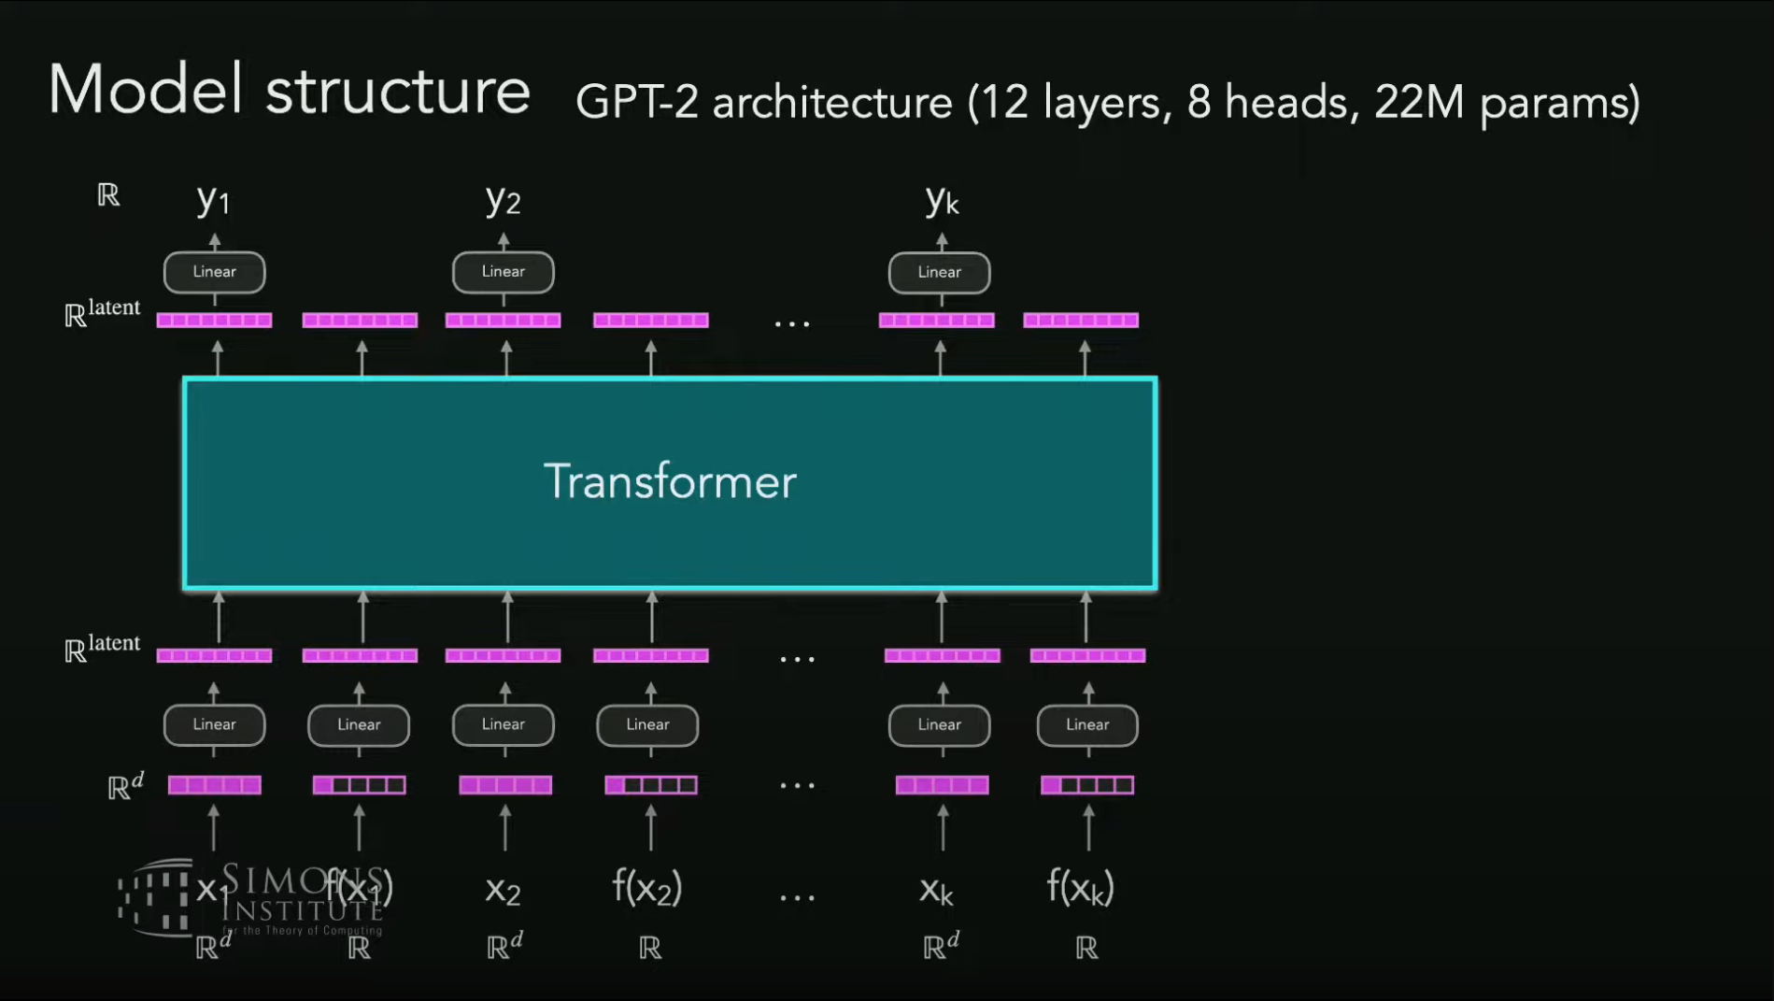

Slide 10
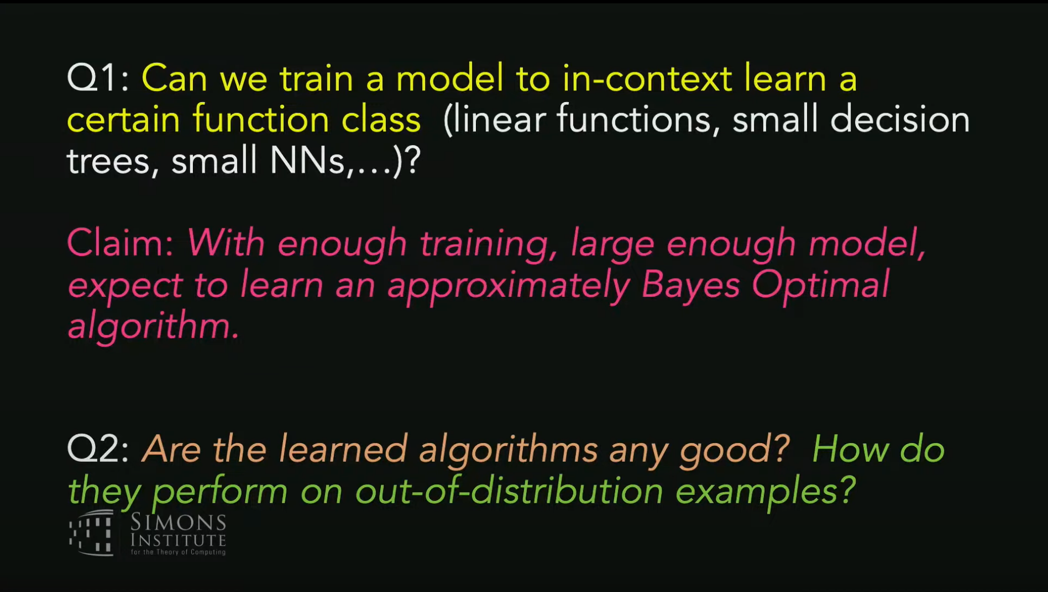

Slide 11
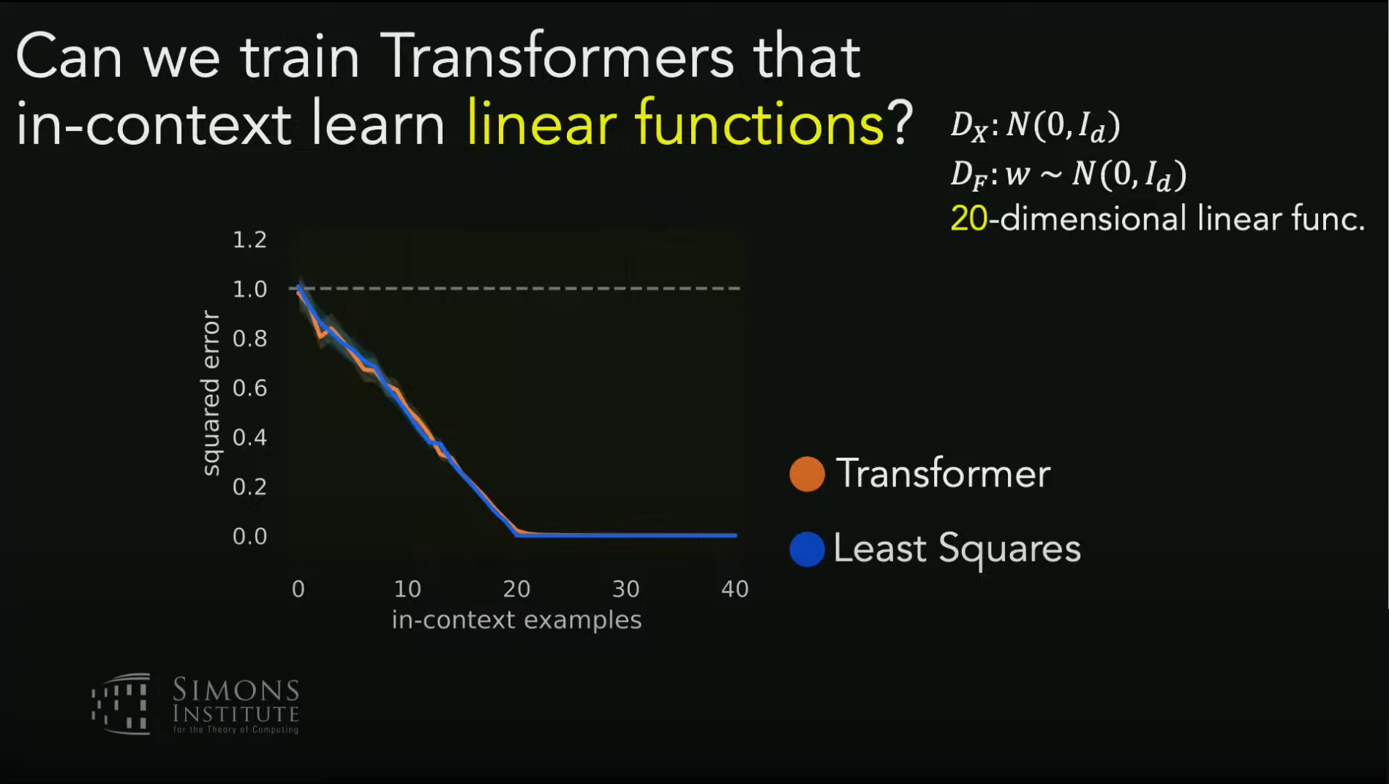
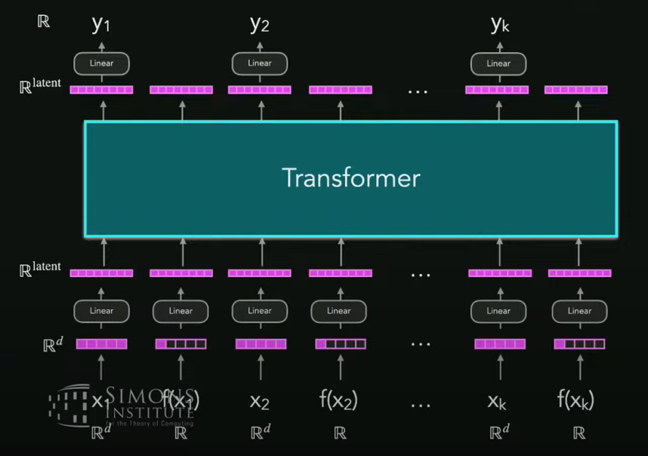
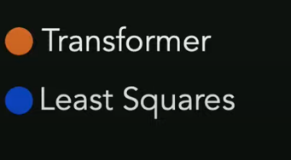

$$f(x) =w x$$

Slide 12
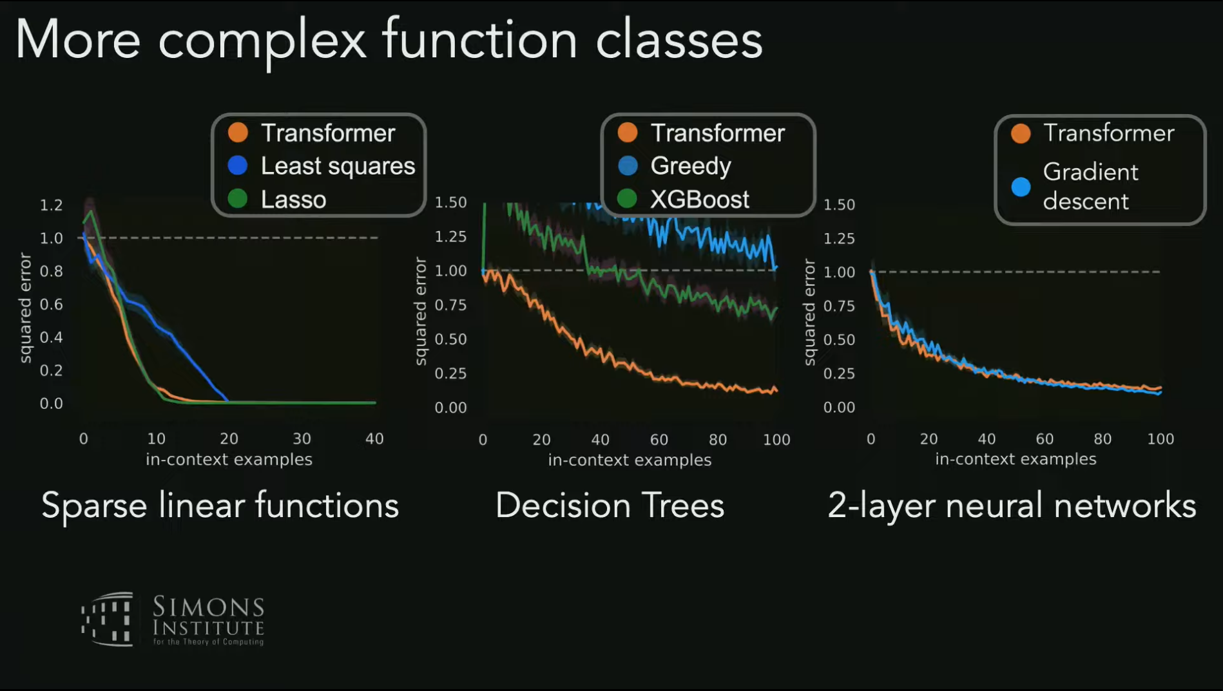

Slide 13
It’s a property of model, independent of how it’s trained!

Slide 14
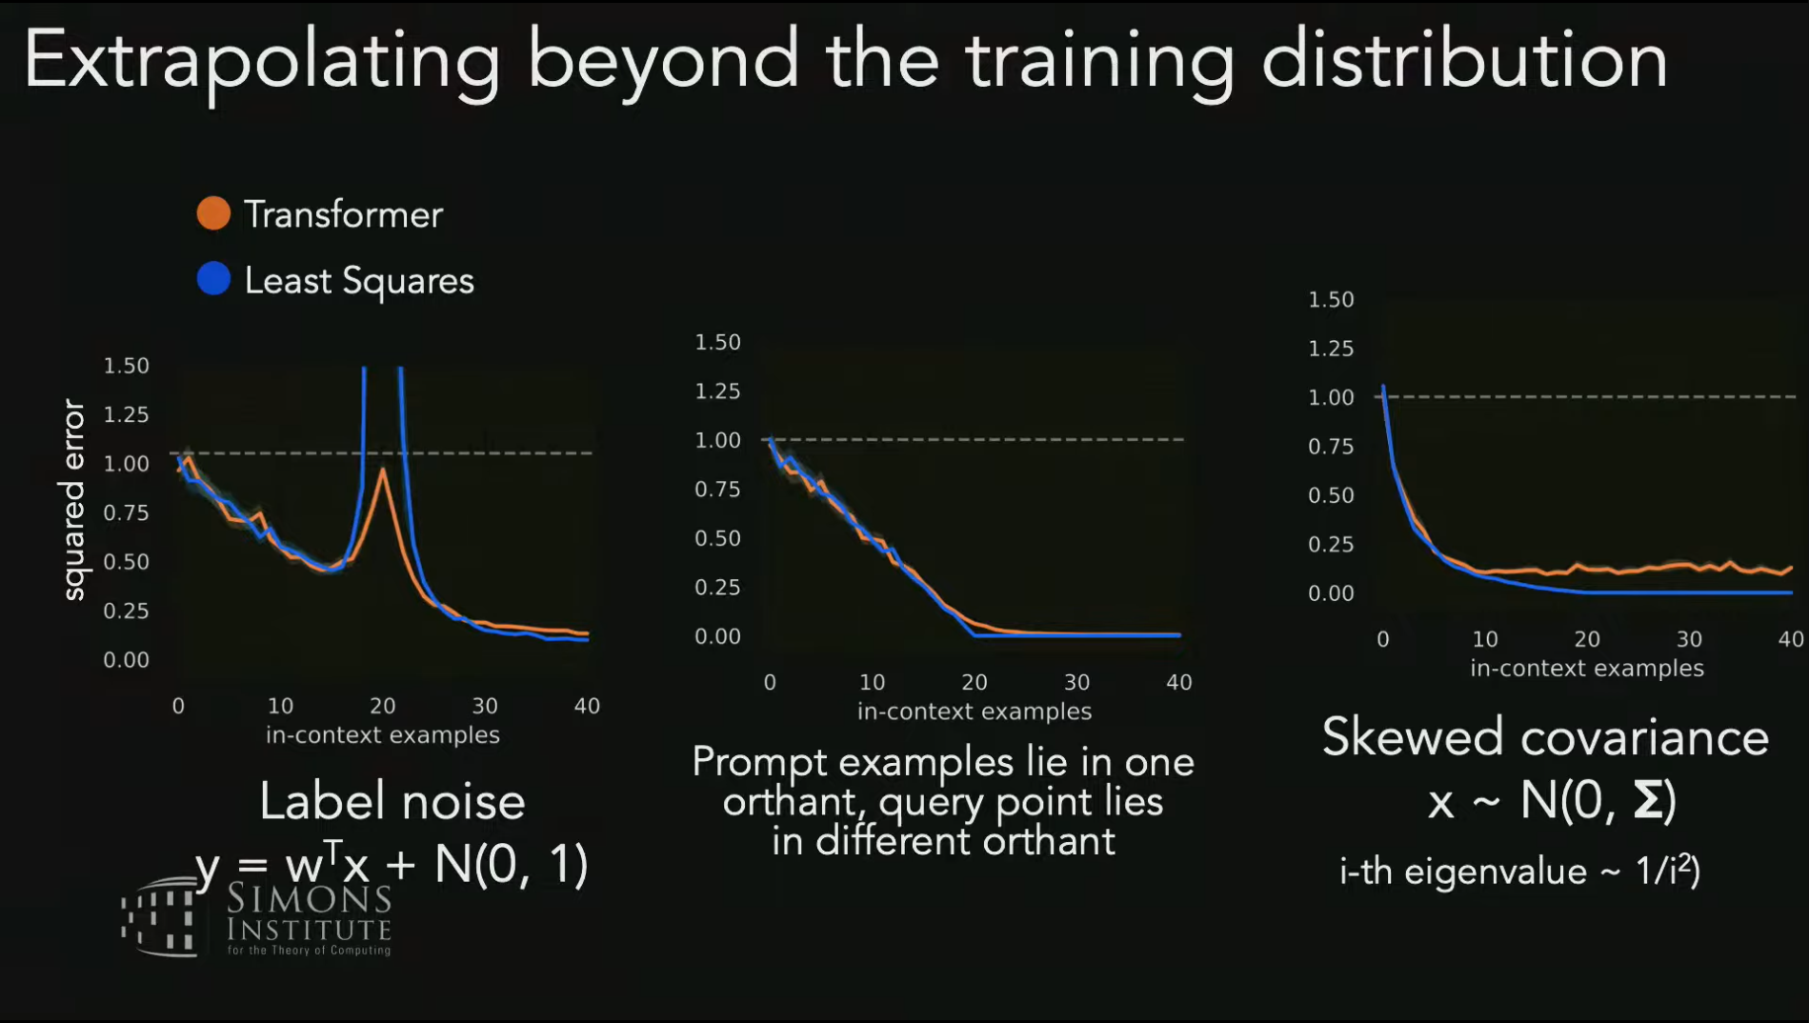
Trained with IID and noiseless
Out-of-distribution prompts at inference time

Slide 15
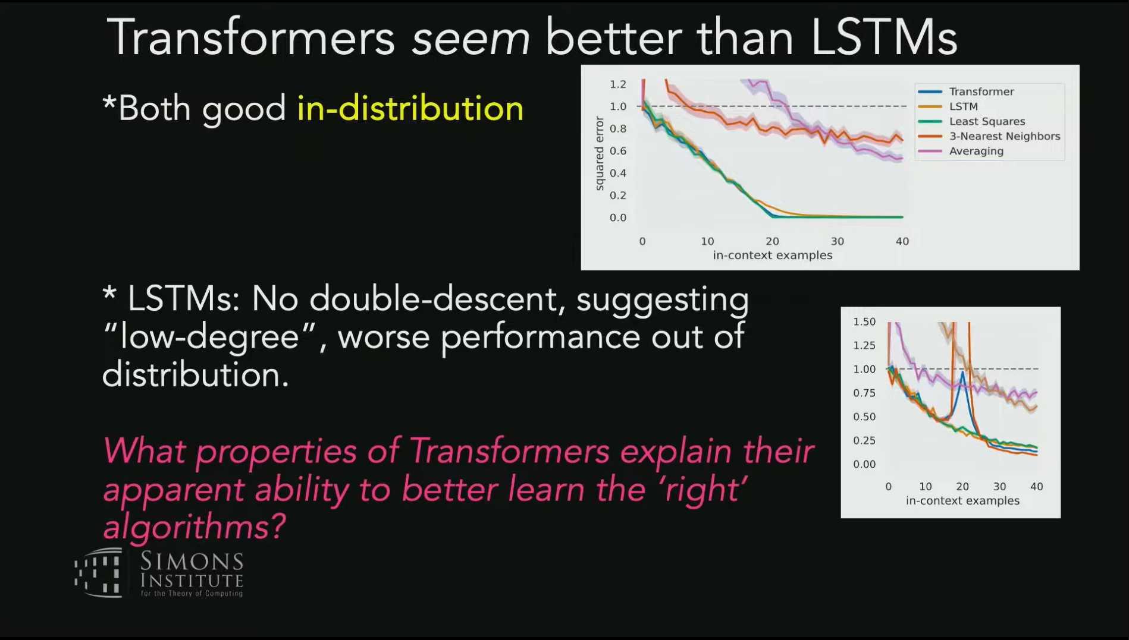

Slide 16
Is it really in-context learning?
Yes. Empirical proof by training in-context learner of simple functions
Are the learned/encoded algorithms any good
Yes. They are robust on out-of-distribution data

Slide 17
What learning algorithms can a Transformer implement?
Gradient descent and Closed-form regression.
Proof that Transformers can simulate classical learning algorithms
Examine learned algorithm computationally.
Similar to Garg et al. paper.
Examine learned algorithm algorithmically.
Probing model

Slide 18
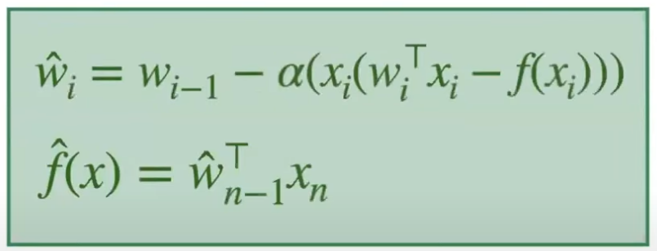
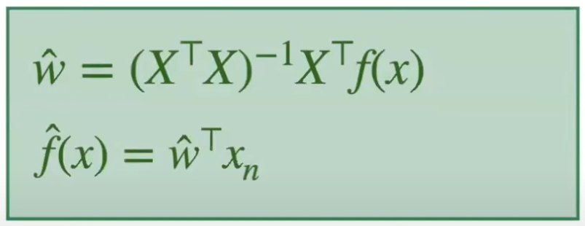
Classical learning algorithms for Linear Regression
single step gradient decent
Closed-form (Normal equation)

Slide 19
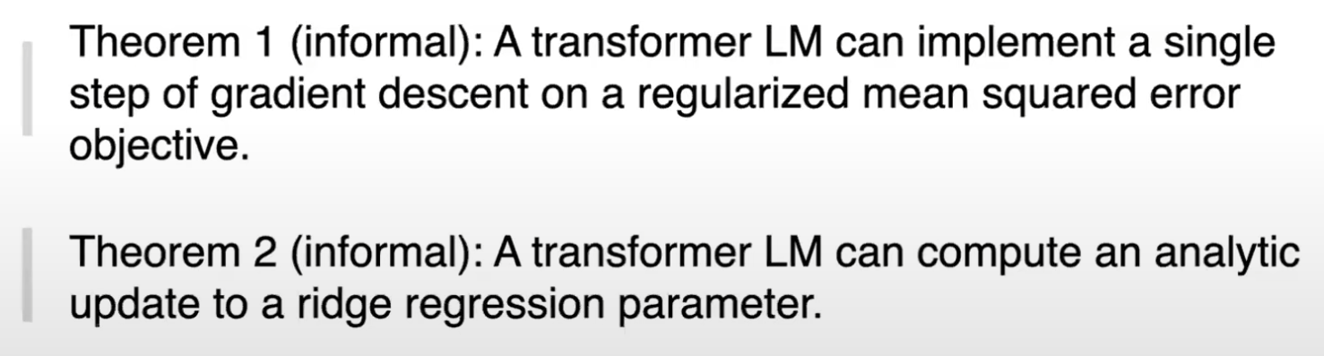
Transformers can simulate classical learning algorithms

Slide 20
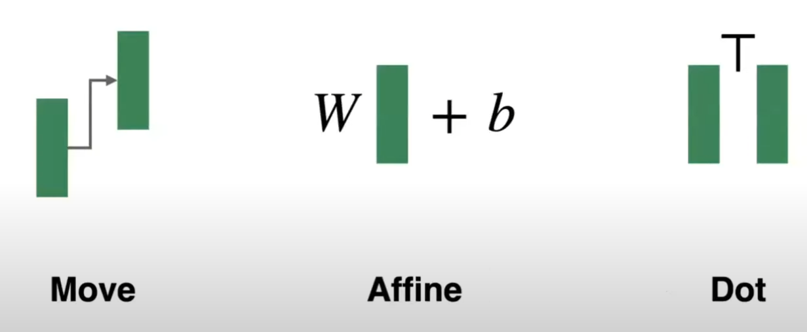
Arithmetic primitives for learning
All can be implemented by a single transformer decoder layer
E.g., Affine by FF layers, Move by self-attention layers

Slide 21
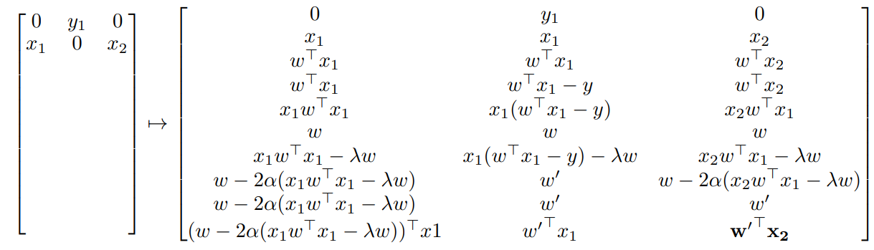
1-step SGD with single exemplar
Input matrix
Forward propagation
Column as Token ; each token is (d+1) dimension
Left to right, sequence direction
Top to bottom, each row is a decoder layer

Slide 22
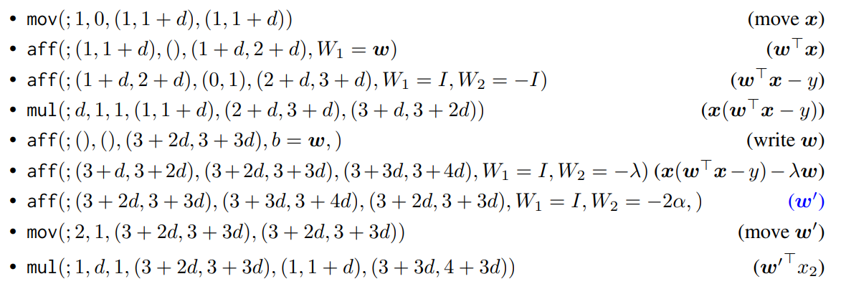
1-step SGD with single exemplar
Just a theoretical possibility; not necessarily what happens in practice

Slide 23
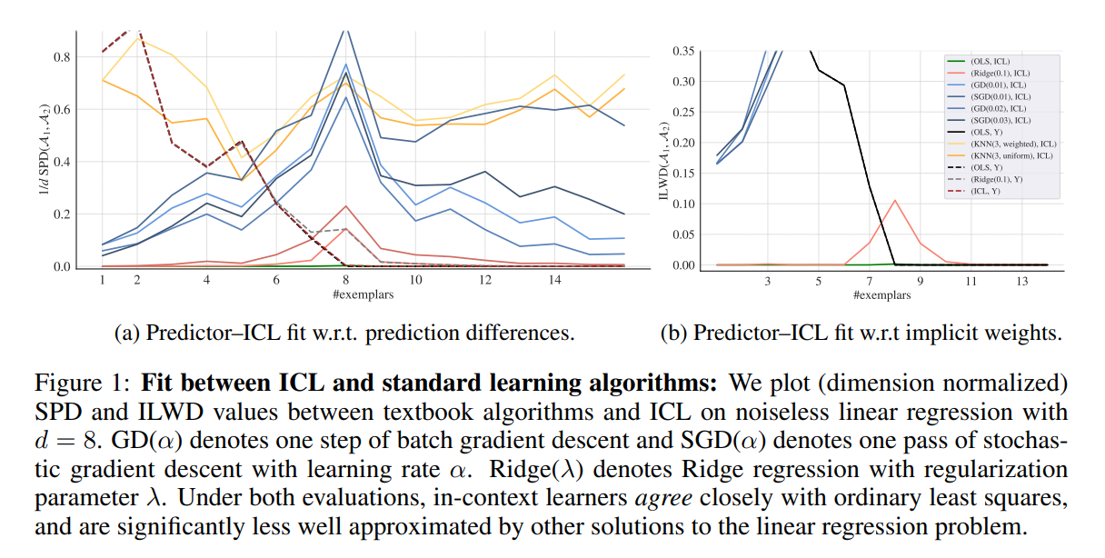
Examine learned algorithm computationally

Slide 24
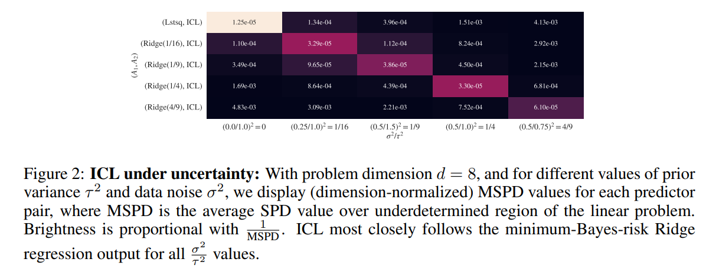
Examine learned algorithm computationally
Similar message as in Garg et al., it learns optimal Ridge for noise data

Slide 25
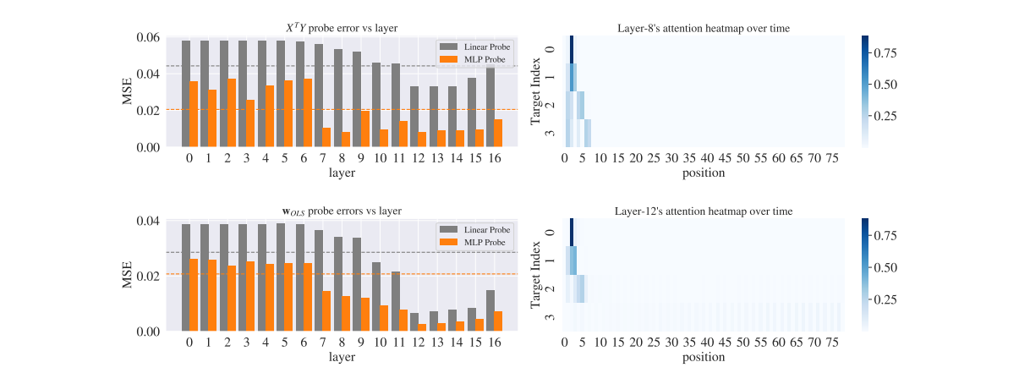
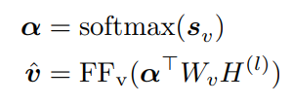
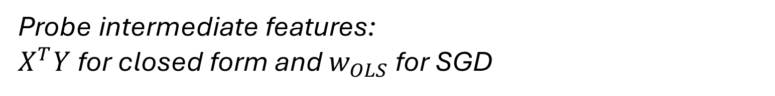
Examine learned algorithm algorithmically
Probe intermediate features:
$X^{T}Y$ for closed form and $w_{OLS}$ for SGD

Slide 26
Takeaways
Transformers is in-context learning (linear regression)
Evidence 1, 2, 3, 4 and 5
It’s a form of meta-learning--learns a class of function
The inductive biases of a linear model is learnt, not predefined.
Think CNN vs VIT
At inference time, the context leads to the correct value of w’s
Maybe it’s not too hard to imagine that LLM finds it necessary to encode similar algorithms to do better information compression during pretraining

Slide 27
References
Stanford paper
https://youtu.be/DiJsg93zQDc
https://slideslive.com/38990662
MIT paper
Double descent
probing

